Slide 1
Swaminarayan college of engineering and technology
Topic: Protection Devices Fuses
Prepared by: Prajapati Divy Guide By:
Prajapati Anant Jigna Parmar
Shah Keyur
patel parth
soni Vishal

Slide 3
Content
Operating principles of fuses
Inverse time/current characteristic of fuses
Fuses used as fault current limiters
Fuses and fault loop impedance
Fuse selection

Slide 4
Circuit Protection
Fuses
Circuit breakers
Next lesson

Slide 5
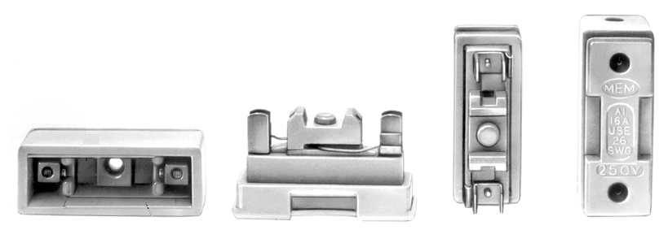
Fuses
Two Basic types
Rewireable

Slide 6
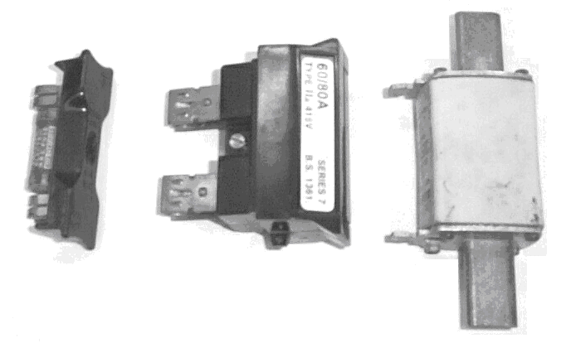
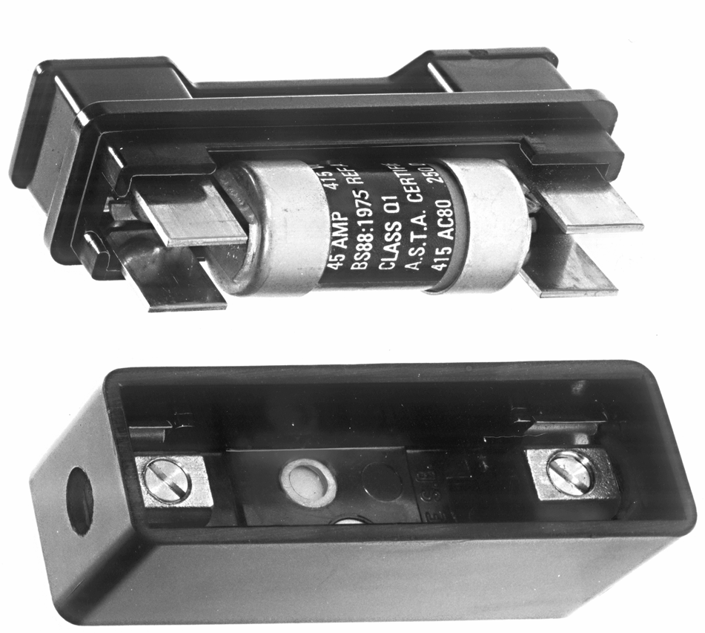
HRC Fuses (High Rupture Capacity)

Slide 7
How Does A Fuse Work?
As current increases, fuse element heats up
Becomes liquid, and falls away.
An arc forms between the ends.
The ends melt away, the arc becomes longer.
Eventually the gap is so great that it is too long for the arc. Current stops flowing
H = I2t

Slide 8
Definitions
The maximum current that a fuse can carry continuously without deterioration
Current Rating
Voltage Rating
Time-Current characteristics
The maximum voltage that the fuse can safely operate.

Slide 9
The minimum current that the fuse element will start to melt
Minimum fusing current

Slide 10
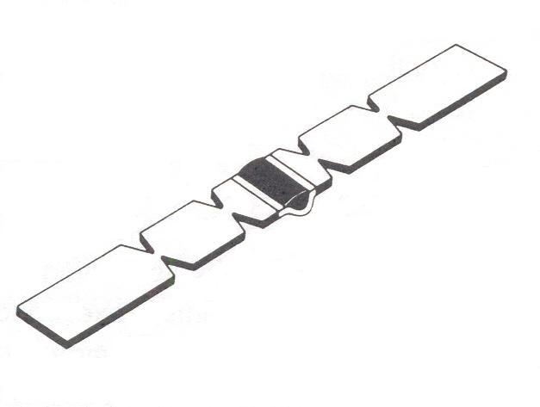
With multiple arc points the time to blow is faster
Standard HRC Fuse Element

Slide 11
HRC Low Voltage
High breaking capacity & energy limitation.
Restriction of electro-mechanical stress on cables and busbars
Reliable short circuit and back-up protection.
Accurate discrimination.
Low over-current protection.
Non-deterioration due to no moving parts

Slide 12
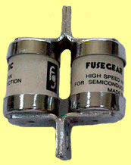
HRC Semiconductor Fuses
Electronics are more sensitive than motors or cables
Energy let through has to be a lot less.
Must be very fast & accurate in operation
Fusing elements are made of all silver, & thinner than standard

